Slide 1
AACRAO Updates
#AACRAO
American Association of Collegiate Registrars and Admissions Officers

Slide 2
Presented by
Ari Kaufman
AACRAO Vice President for Finance

Slide 3
Bylaw Changes

Slide 4
AACRAO recently approved these three bylaw changes:
Virtual Voting
Board Designates Membership Structure – Eliminating Roster Limits
Improve Association Budgeting
All three bylaw changes were approved by the membership at the 2023 Annual Business Meeting on March 28, 2023

Slide 5
Virtual Voting
Starting at Annual Meeting 2024, all voting members, regardless of their registration status at the Annual Meeting, will be able to virtually attend the business meeting and vote on any items on the agenda.

Slide 6
Board Designates Membership Structure
Over the course of the next year, the Board will move to adopt a new membership structure that will transform our ability to serve the profession.
The current structure designates dues level and number of seats allotted based on an institutional FTE calculation from IPEDS data.
The new structure being considered will use institutional budget expenditures as reported on IPEDS to designate dues level with an unlimited roster.

Slide 7
Improve Association Budgeting
The following processes have been added to the AACRAO Operational Policy and Procedure Guidelines in order to enhance member transparency into budget processes:
June: The AACRAO Annual Budget will be prepared by the staff for initial review by the Finance, Investments and Audit Committee and the Board.
August 1: The FI&A Committee will host a virtual town hall to allow for member comment on the budget. The Board will approve the budget for October 1 implementation.

Slide 8
2023 AACRAO Elections
Voting Window: September 11 – October 31, 2023
Open to Voting Members only
Notes:
Must login to vote - https://www.aacrao.org/who-we-are/leadership/vote

Slide 9
AACRAO’s New Campaigning Policy
Who do the guidelines apply to?
Individuals running for a Board of Directors of N&E position
Members of state and regional associations who have candidates on an AACRAO slate from their state/region
Other AACRAO members
Members of a candidate’s home institution
(This is not an exhaustive list)
What is permissible?
Encouraging all members to vote, but no direct “vote for me” or “vote for X”!
Notes:
Full Campaigning Guidelines can be found on the AACRAO voting page - https://www.aacrao.org/docs/default-source/governance/aacrao-campaigning-policy-9-5-2023.pdf?sfvrsn=38d4de64_1

Slide 12
Free Webinar: November 8 at 2 PM ET
State & Regional Board Member Networking
Notes:
Registration Opening Soon

Slide 13
FREE WEBINAR: January 17, 2024 at 2 PM ET
Ask the FERPA Professor
Notes:
AACRAO is taking the well-loved AACRAO annual meeting session favorite, “Ask the FERPA Professor with LeRoy Rooker”, on the road and we invite you to join moderator, Dr. Helen B. Garrett, University of Washington, as she facilitates LeRoy responding to your FERPA questions. Whether you are new to FERPA or are a seasoned expert, this webinar will allow you to come with your burning FERPA questions and to ask the top expert of them all, LeRoy Rooker. The format will be a webinar where you can post your questions in the chat and LeRoy will respond.

Slide 14
Notes:
AACRAO SEM Conference| November 5-8, 2023| Registration opening soon.

Slide 15
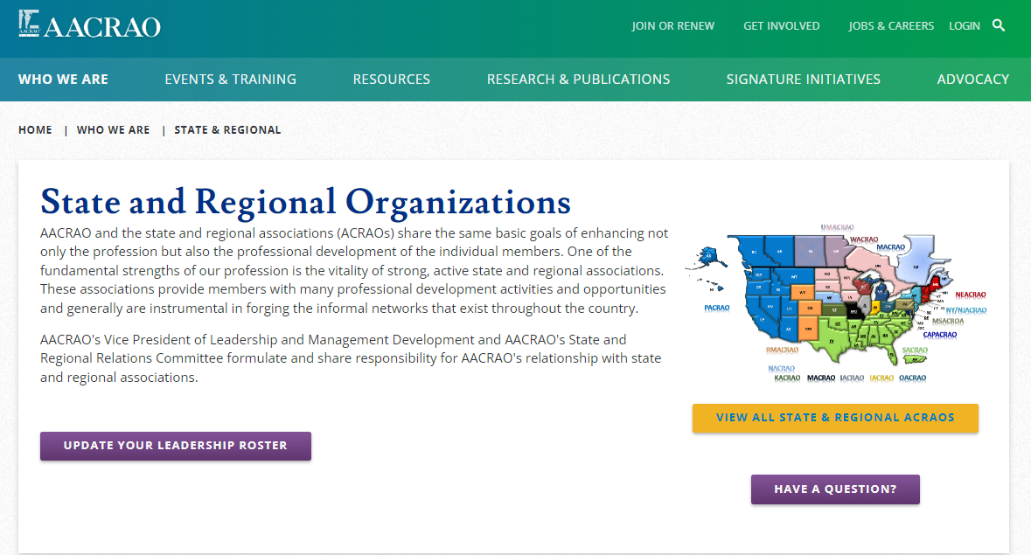
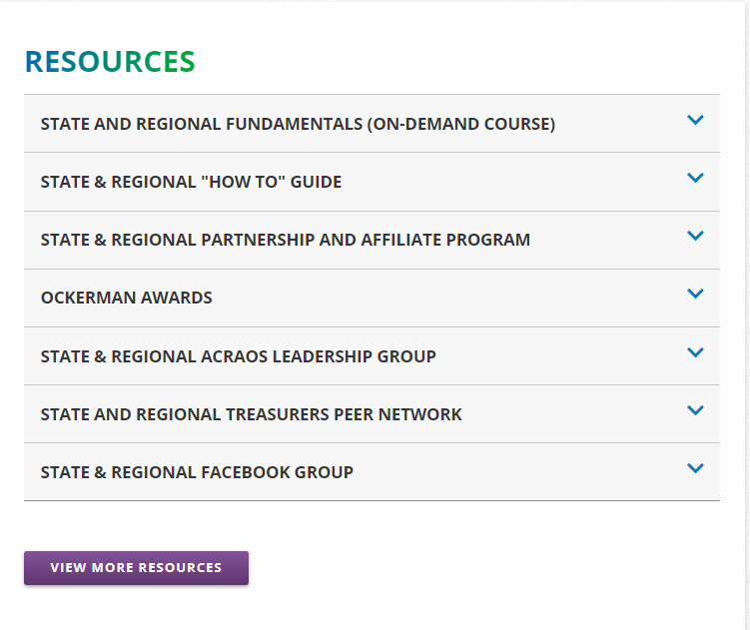
Core Competencies and Proficiencies
Notes:
There’s a whole webpage for our State and Regional Organizations
Update your leadership roster
Request an AACRAO rep for your conference
Learn about upcoming S&R related events and trainings
Read the S&R “How To” Guide
Join the S&R Treasurers Group
Join the S&R Leadership Group

Slide 16
On-Demand Courses & Micro-Credentials
Notes:
The State and Regional Fundamentals is FREE for both member and non-members.
In addition to our traditional cohort faculty led online courses like Reg 101 , The Essentials of SEM and Project Management, we now offer more than 20 self-paced learning modules that are tied to the competencies and proficiencies that you need to do you job—its learning available when you want it at a price that is affordable. We have several foundational courses that are free for members, and all of our self-paced modules offer a micro-credential upon completion. Whether you want to upskill yourself or train new staff, AACRAO has the learning you need to keep you current in your role.
There are more than a dozen more courses in development, and we are currently seeking faculty on a variety of topics in the records profession, so if you have knowledge to share and want to get involved, find me at the conference.

Slide 17
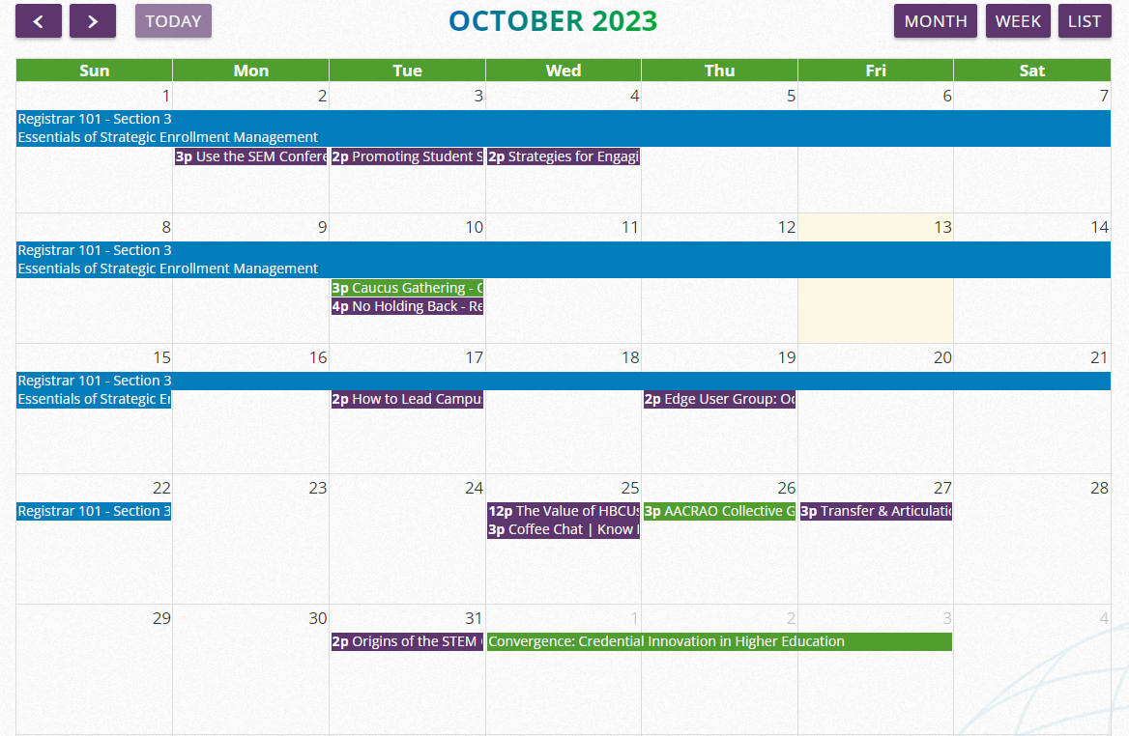
Connect, Learn, Grow
Notes:
Virtual and in-person meetings, webinars, coffee breaks, traditional cohort-based online courses, and more can be found in the calendar. Visit often, because new things are added daily. Watch your inbox for This month at AACRAO, which highlights some of the many opportunities. And while we would prefer you join, we know that isn’t always possible. Every month we have *some* opportunities available for non-members.

Slide 18
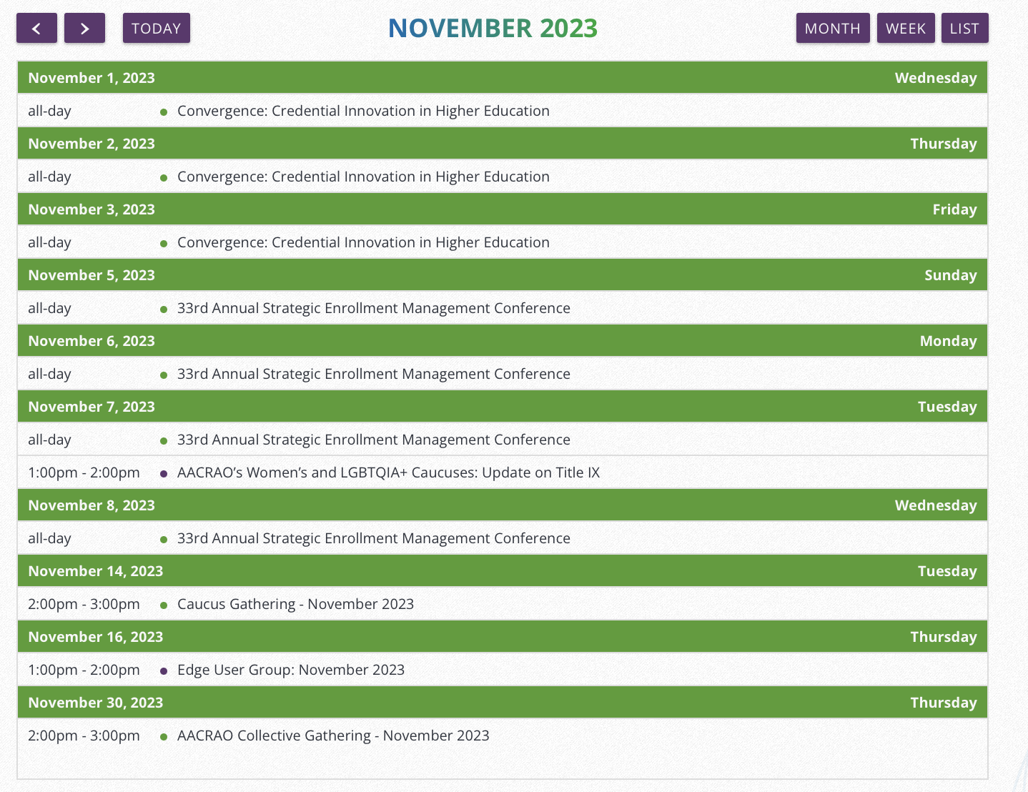
Connect, Learn, Grow
Notes:
Virtual and in-person meetings, webinars, coffee breaks, traditional cohort-based online courses, and more can be found in the calendar. Visit often, because new things are added daily. Watch your inbox for This month at AACRAO, which highlights some of the many opportunities. And while we would prefer you join, we know that isn’t always possible. Every month we have *some* opportunities available for non-members.

Slide 19
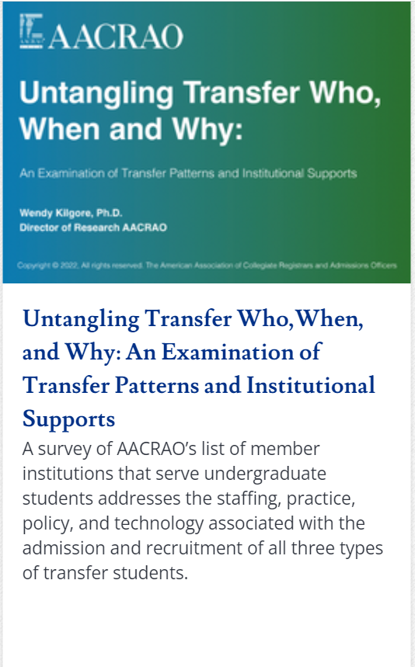
AACRAO Research
Notes:
For a full list of reports, visit https://www.aacrao.org/research-publications/research

Slide 20
Newest AACRAO Publications
Notes:
Newest Release – SEM in Action
A few other popular recent releases:
The Effectiveness of SEM
The Basic Guide to Financial Aid
Link to the full catalogue - https://www.aacrao.org/docs/default-source/pubs/aacrao-publications-catalog-2022-2023.pdf?sfvrsn=3e40a978_2

Slide 21
Need to benchmark your policy, or write a new one? Do your research first! FREE for roster members!
Notes:
The culmination of a two year project with AACRAO Corporate Partner College Source has resulted in the launch of Higher Ed Policy a searchable database of institutional catalog-based policy. Extensively beta-tested by select AACRAO members, this project was fully released earlier this month. . Accessible only to roster members from AACRAO member institutions, Higher Ed Policy Central gives users the ability to explore, compare, and analyze institutional policies from more than 1200 institutions of all types and sizes. This tool assists policy writers, researchers, and AACRAO members as a whole.

Slide 22
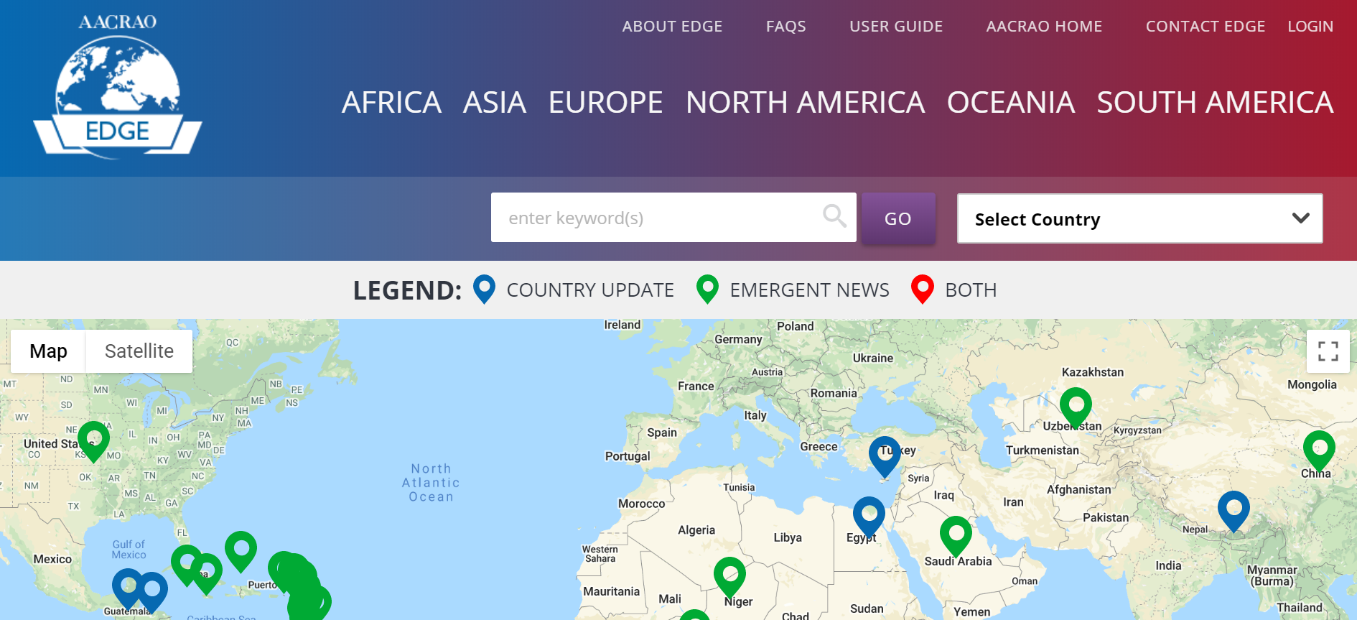
Notes:
AACRAO EDGE continues to get updated frequently. For a list of the latest updates, please visit https://www.aacrao.org/edge

Slide 23
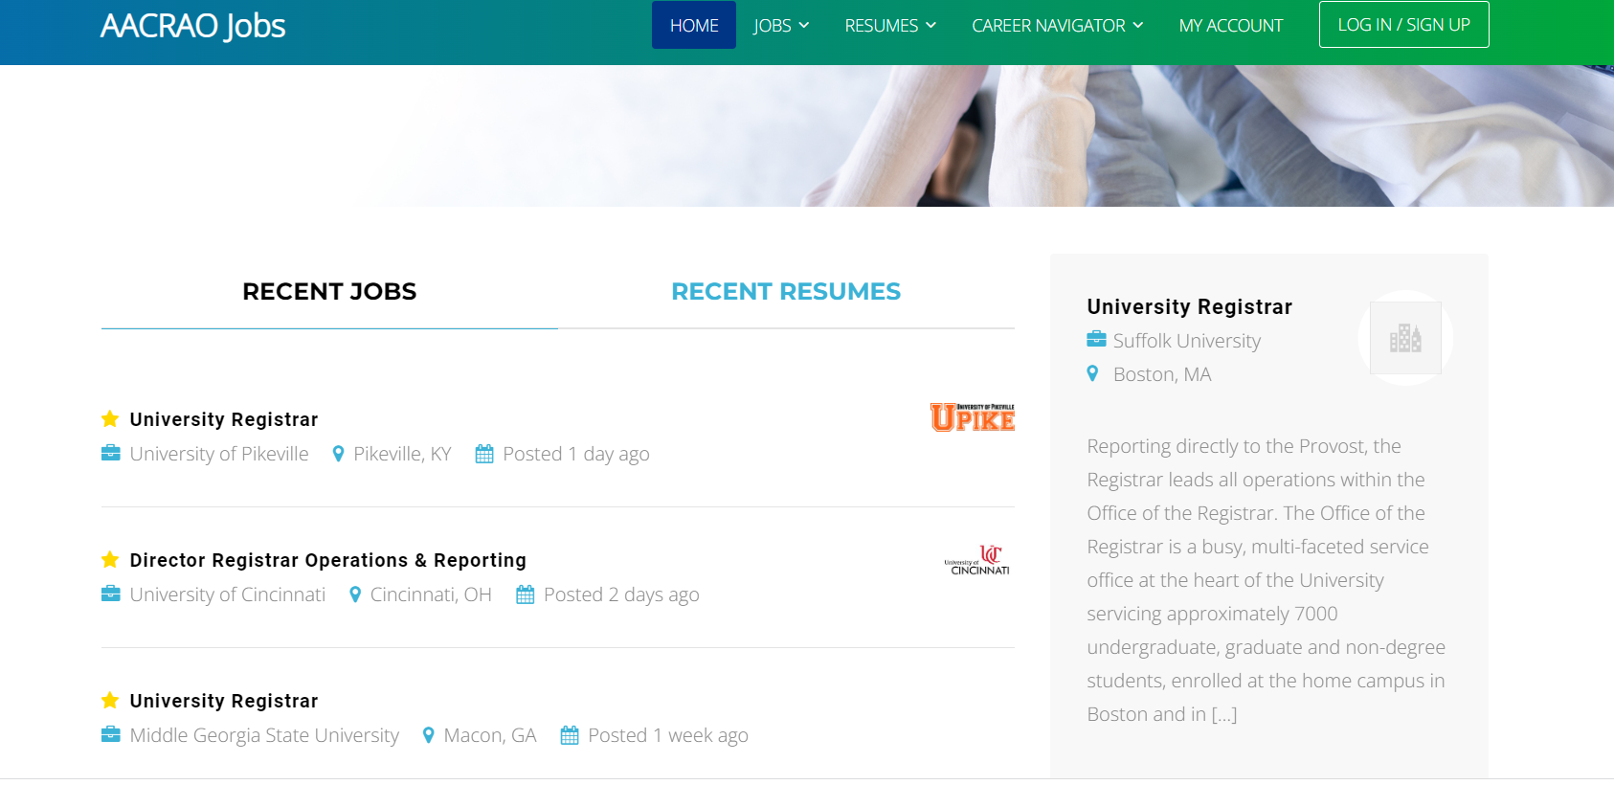
Notes:
As of March 2020, Jobs Online was rebranded as AACRAO Jobs.
An email newsletter is sent monthly to all members with information about the most recent postings on AACRAO jobs.
Weekly outreach efforts continue to be made weekly to institutions and companies advertising higher education jobs.

Slide 24
AACRAO Book Club & Podcasts
Notes:
Our Book clubs and podcasts are free resources for members and non-members alike.
Our newest podcast is Transfer Tea
Join the email list for updates on the next book club meeting and selection - https://www.aacrao.org/who-we-are/aacrao-community/book-club

Slide 26
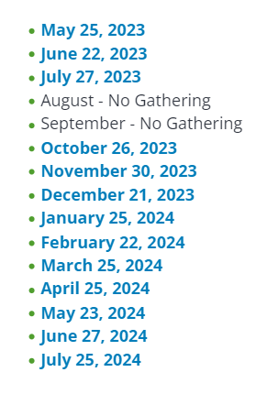
OR
Notes:
AACRAO Members can gather on the fourth Thursday of most months. Attend, submit your discussion ideas or become a moderator.
Upcoming Meeting Dates are attached for 2023.

Slide 27
Notes:
Our Caucuses, which are identity-based special interest groups, meet via zoom monthly for support, networking and educational activities. The caucuses also help us to organize our webinar offerings.
Newest Caucus – Young Professionals Caucus

Slide 28
Notes:
There are lots of ways to get involved. Consider joining a Committee, Caucus, or write for AACRAO. The opportunities are endless.
Open Positions – Course Faculty Member, Managing Consultant
Volunteer Opportunities – Collective Gathering Moderator, SEM-EP Evaluator

Slide 29
JOIN THE CONVERSATION
@aacrao

